Slide 1
EAD Post Mid Project
SUBMITTED BY : AYESHA ARSHAD
ROLL NUMBER : BCSF20M028
SUBMITTED TO : SYED RIZWAN ALI

Slide 2
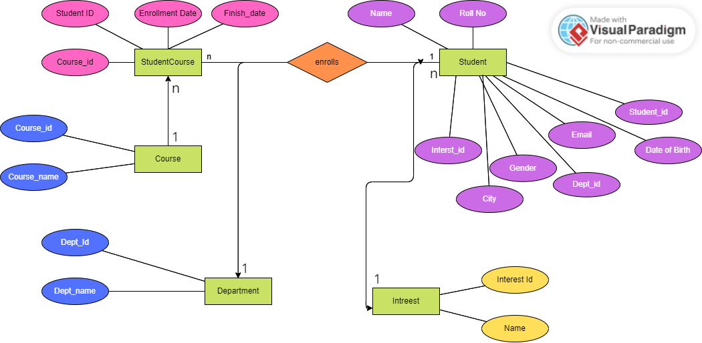
ERD Diagram

Slide 3
I choose :
React Js for Frontend
Django for Backend
Reason for choosing this combination is that during internship I learned Djnago and I react so I want to utilize this and want to make a full working application.

Slide 4
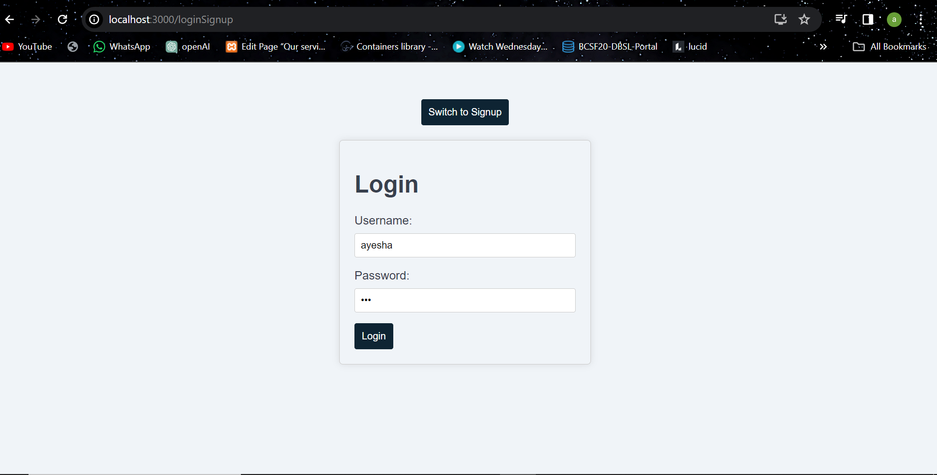
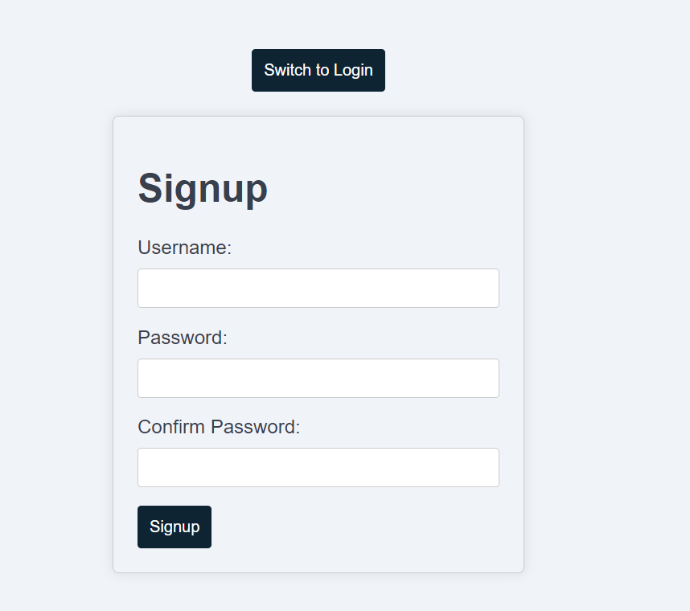
Flow

Slide 5
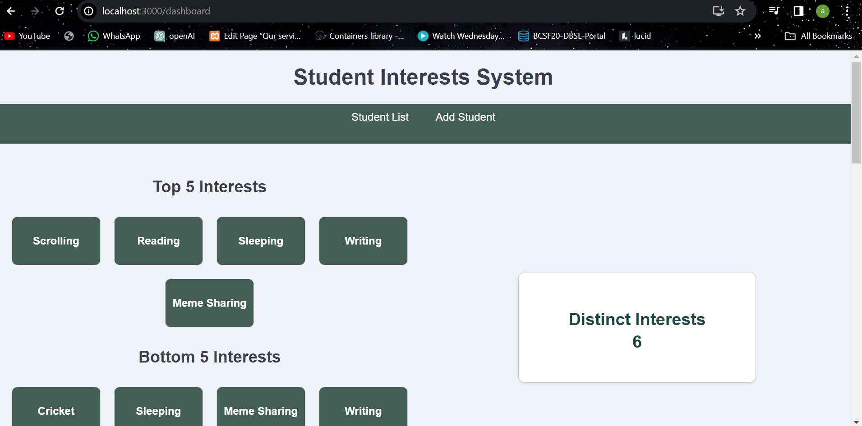
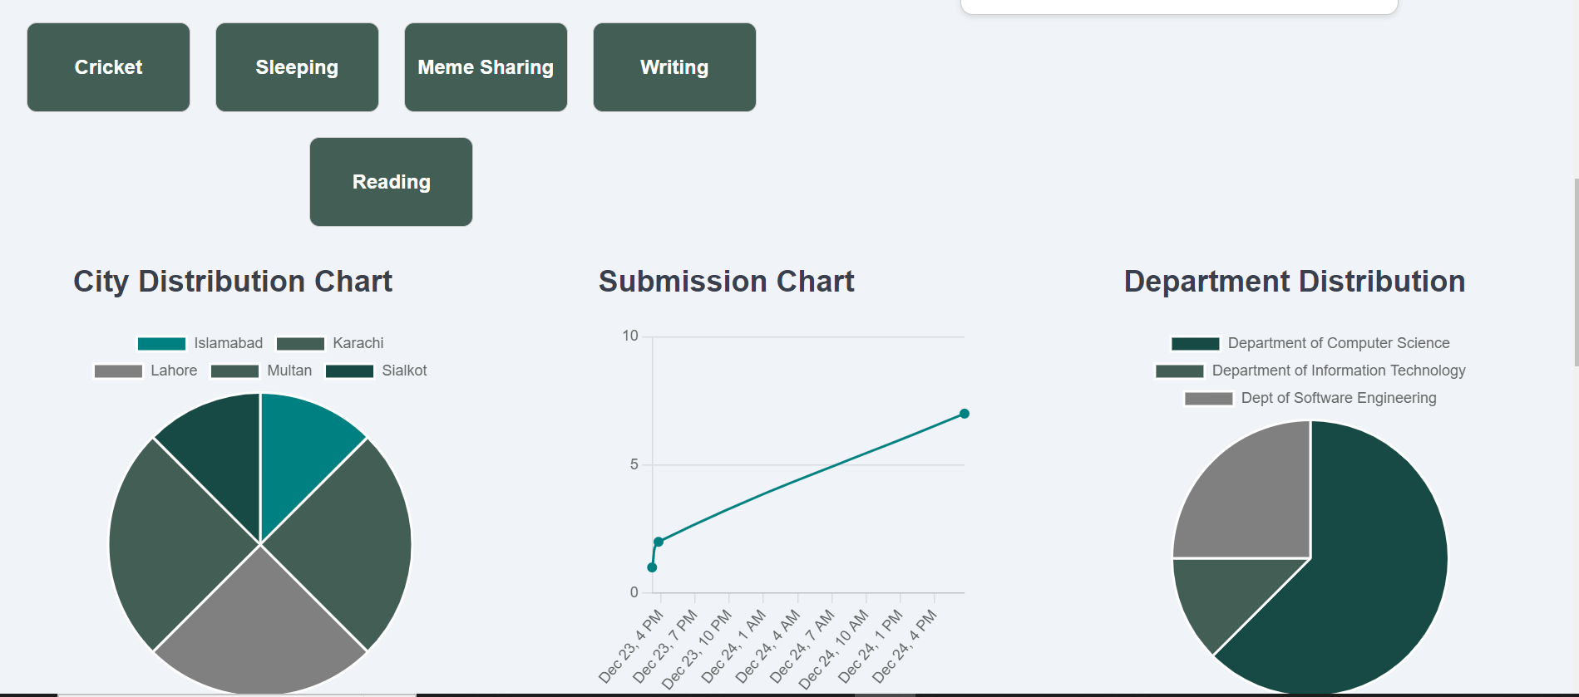

Slide 6
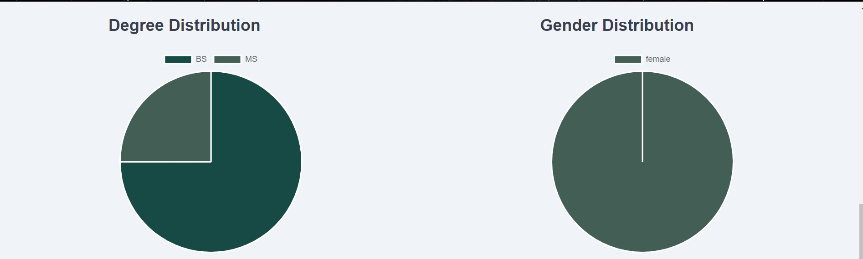
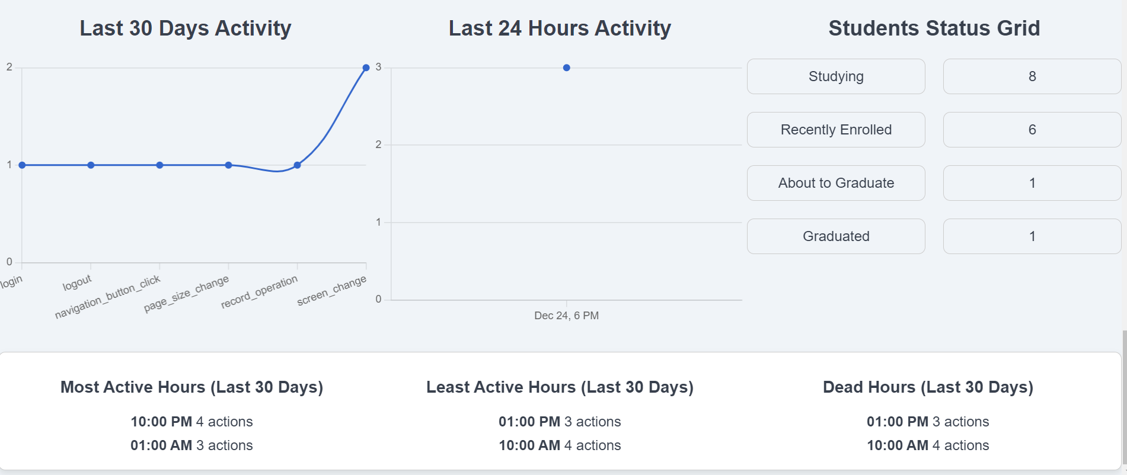

Slide 7
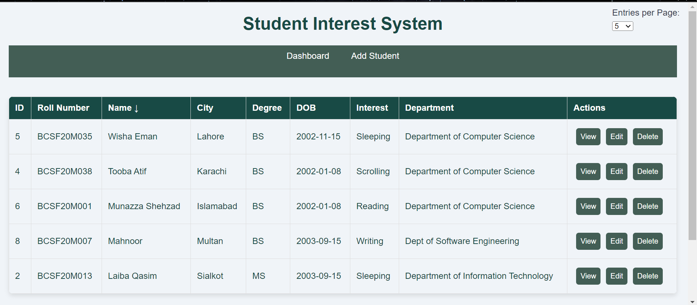
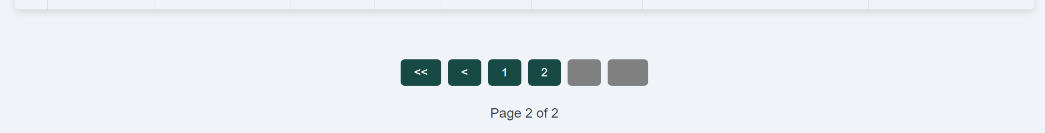

Slide 8
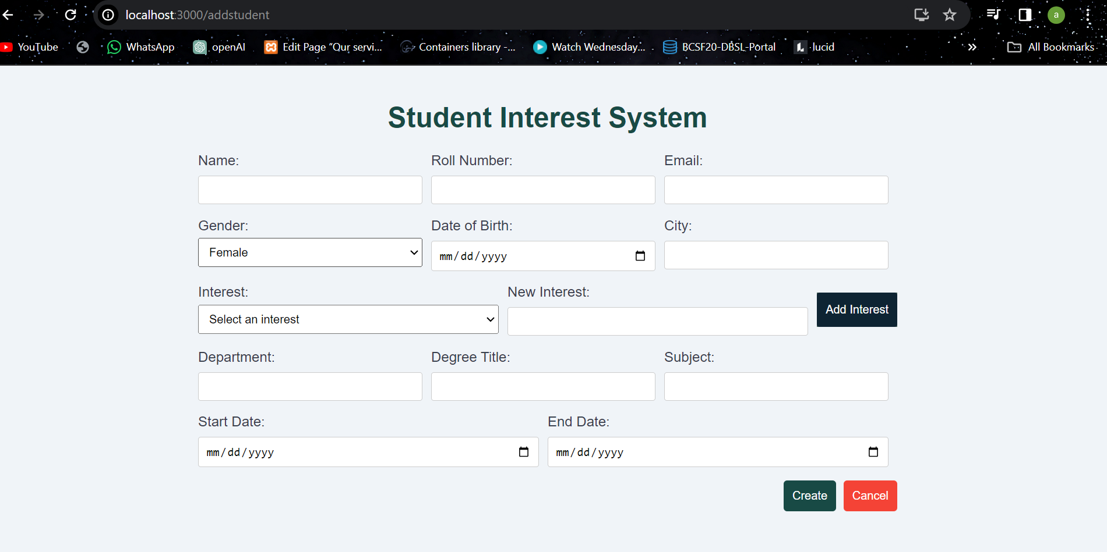

Slide 9
